Slide 1
Reagents
OBI workshop
San Diego 2011

Slide 2
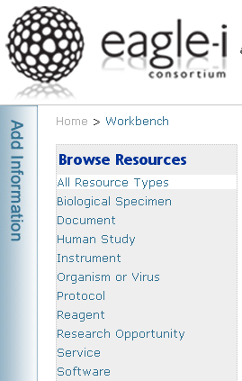
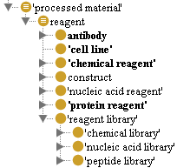
eagle-i and OBI: reagents
Reagents are one of ten “Root Resources” inventoried by eagle-I.
Text def: “a processed material used in a chemical reaction or other experimental process to detect, measure, examine, or produce other substances.”
Logical def: 'processed material’ and (has_role some 'reagent role')
‘reagent role’ and ‘processed material’ classes are imported from OBI
Reagents are further partitioned into several categories for which instance data is collected.

Slide 3
OBI: reagents
No ‘reagent’ class, but a ‘reagent role’
Defined as “a role played by a molecular entity used to produce a chemical reaction to detect, measure, or produce other substances”
Usage of ‘reagent role’ limited to property restrictions for a handful of ‘assay’ class definitions
Example: ‘DMS structure mapping assay’
realizes some ('reagent role' and (inheres_in some
'Dimethyl sulfate'))
Classes representing materials that would be considered reagents (‘cloning vector’, ‘cell culture’, ‘recombinant plasmid’) are mostly found as children of ‘material entity’ in OBI

Slide 4
eagle-i and OBI: reagents
Issues
Need a consistent definition for ‘reagent’
a ‘processed material’ vs a ‘molecular entity’ vs ‘material entity’
eagle-i reagents such as ‘cell line’, and ‘reagent library’ no qualify as molecular entities
currently, many reagents in OBI are classified as ‘material entities’ rather than ‘processed material’
Modeling Approach
Reagent : ‘processed material’ and has_role some ‘reagent role’
Build an asserted reagent hierarchy under ‘processed material’
Defined classes will be created to suit needs of eagle-i users
Shortcut relations desired for creating defined classes
What will be merged into OBI and what will live in eagle-i?
Who wants to be involved and how to proceed?
Notes:
expression construct -> expressed_in_organism -> organism
rather than
expression construct -> participates_in -> gene_ expression -> has_participant -> organism
Example of defined reagent class : gene knockdown reagent (has function gene knockdown), RNAi reagent (has function RNAi function), cell culture reagent (participates in cell culture process)

Slide 5
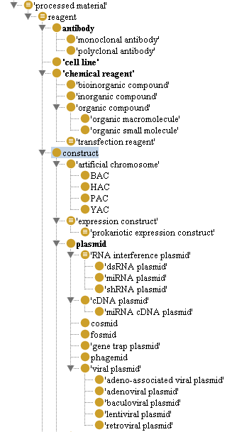
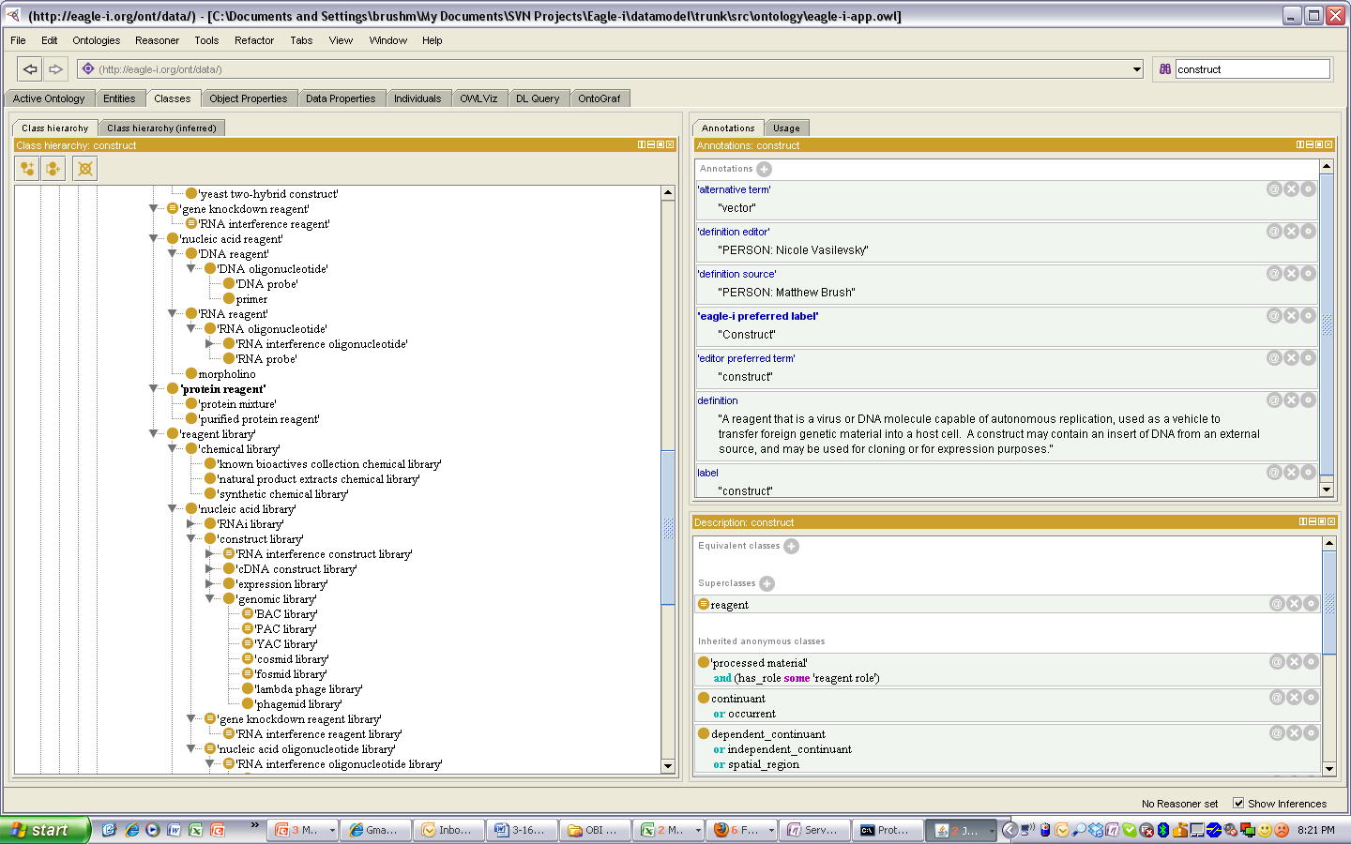
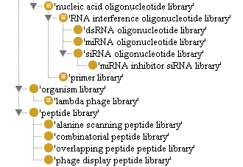
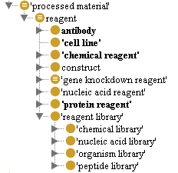
eagle-i and OBI: reagents
Top Level Reagents

Slide 6
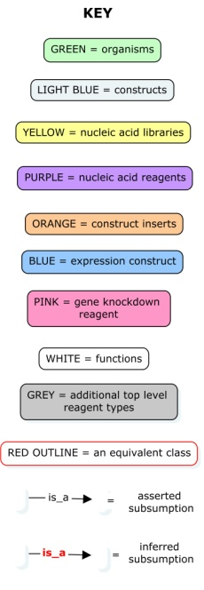
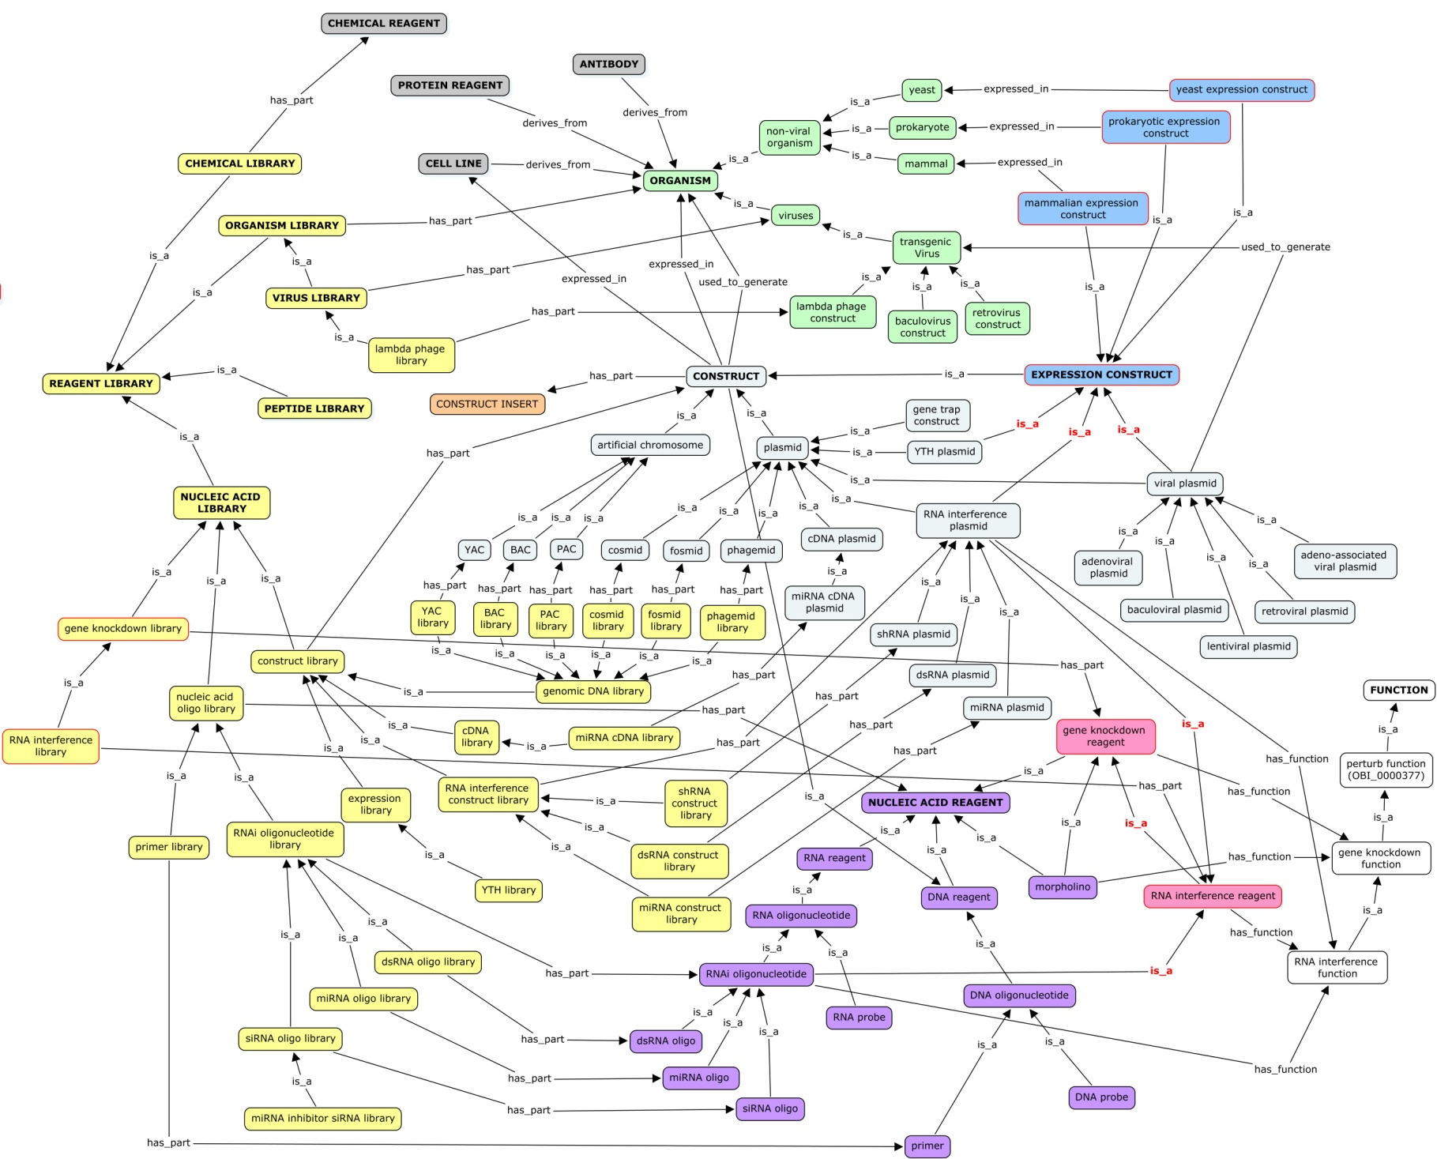
Reagents in eagle-i

Slide 7
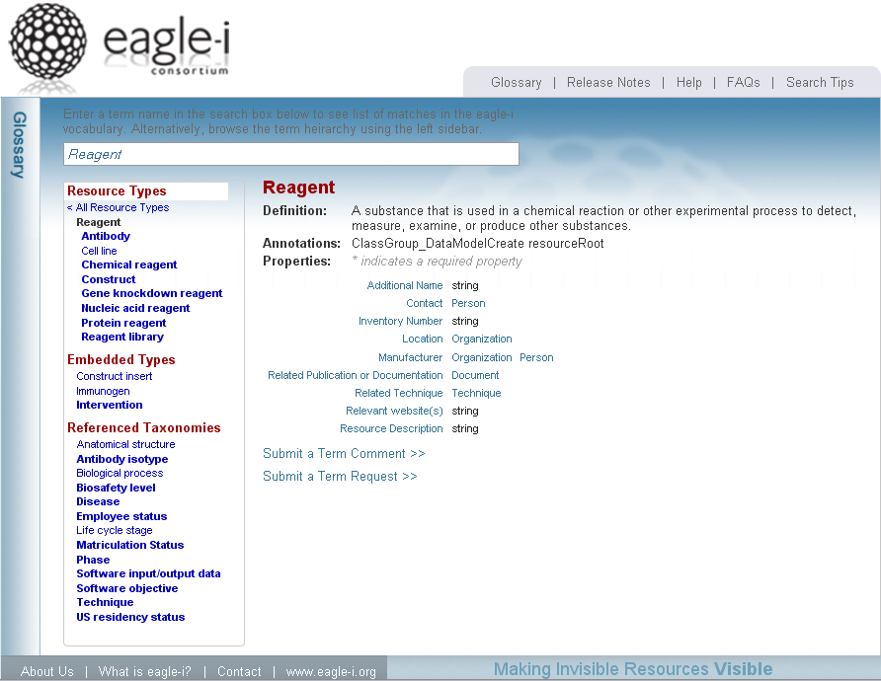

Slide 8
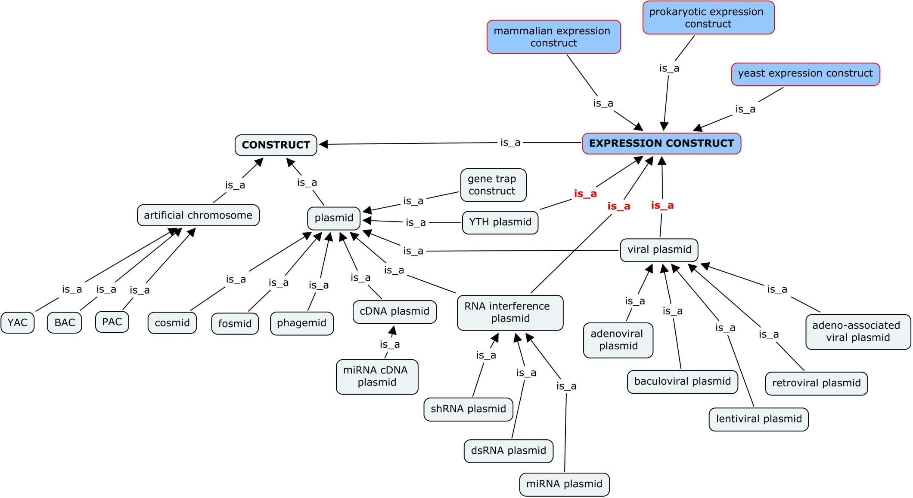
Constructs in eagle-i

Slide 9
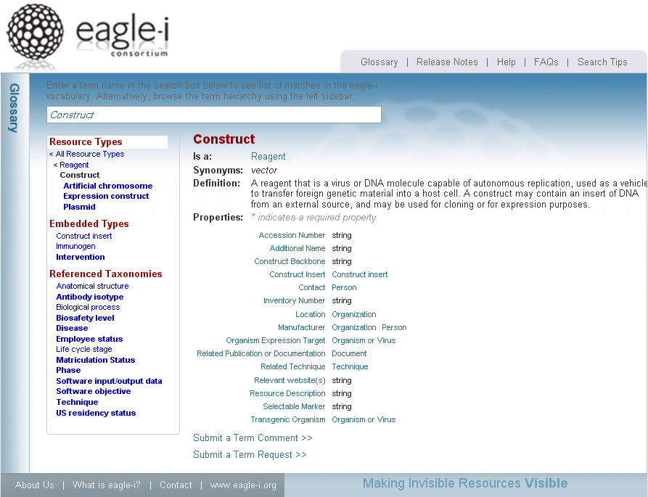

Slide 10
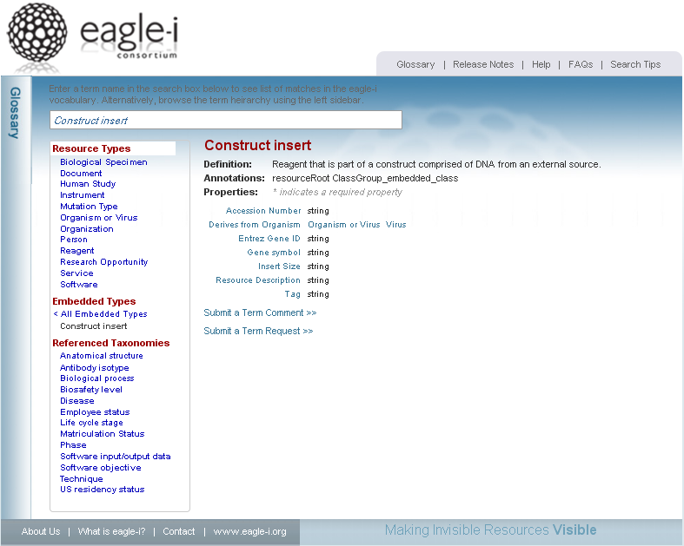

Slide 11
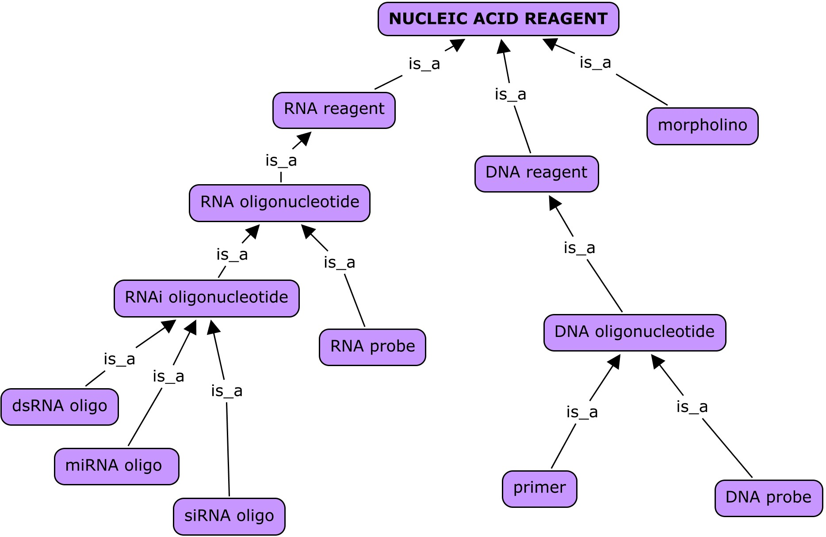
Nucleic Acid Reagents in eagle-i

Slide 12
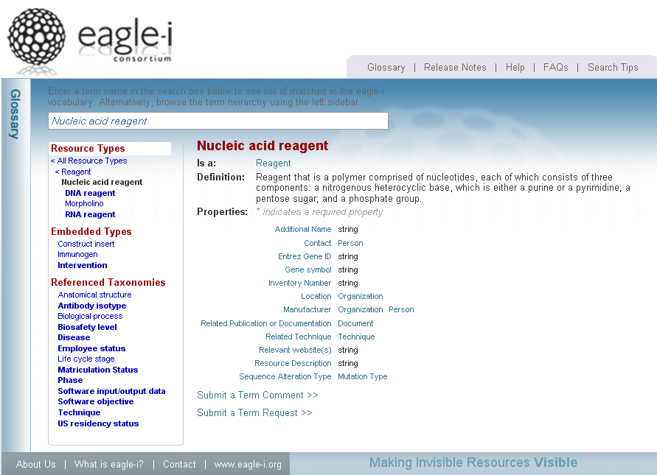

Slide 13
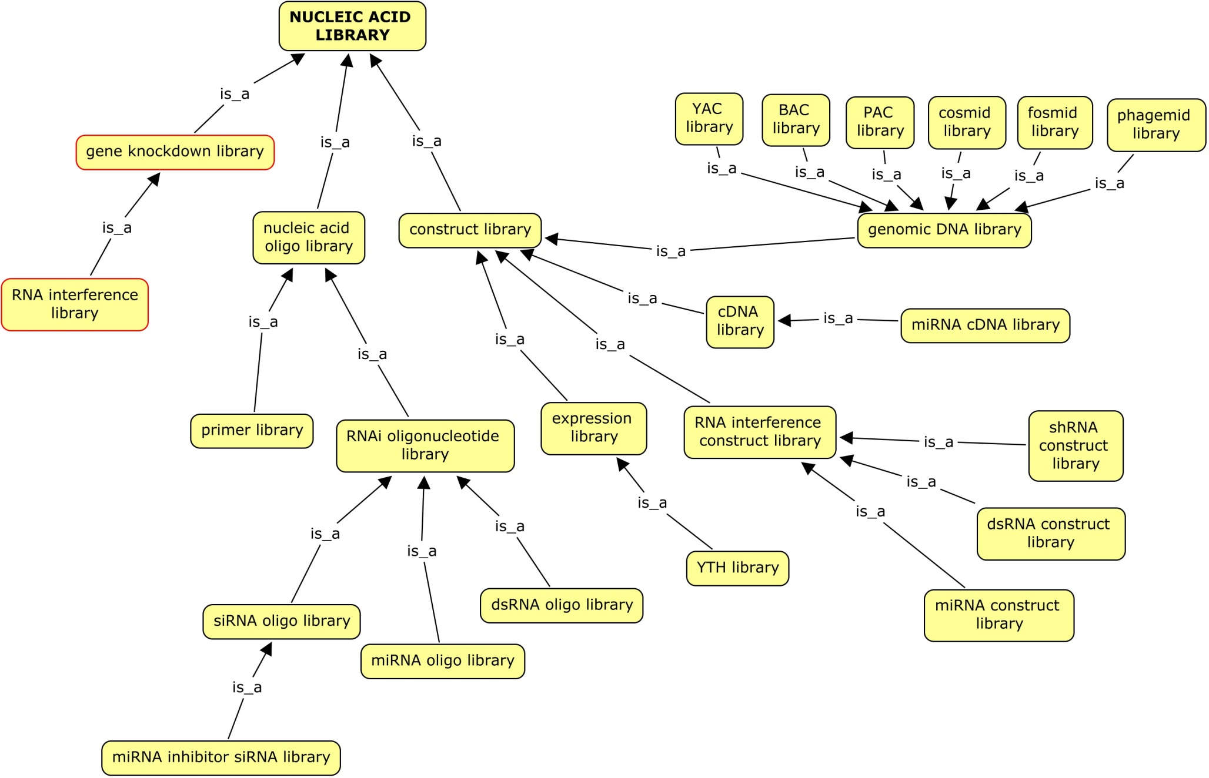
Nucleic Acid Libraries in eagle-i

Slide 14
